Slide 1
Doc 4.2(1) - High Level Guidance on the Evolution of Global Observing Systems during the period 2023–2027 in response to the Vision for the WMO Integrated Global Observing System (WIGOS) in 2040
The 19th World Meteorological Congress
Estelle Grueter, Chair, INFCOM/SC-ON
Erik Andersson, Chair, INFCOM/SC-ON/JET-EOSDE
24 May 2023

Slide 2
High Level Guidance in response to WIGOS Vision 2040
The High Level Guide
consists of principles of a general nature that should be considered for the development of implementation plans by Members, agencies, and other operators of observing networks.
It also
identifies urgent specific actions arising as a consequence of WMO’s Earth System approach and priorities of WIGOS, WMO programmes, and existing data gaps
 | 2

Slide 3
The task was: “A guidance doc for the evolution of WIGOS will be developed.”
The high-level guide considers surface and space-based observing systems. It is based on:
the findings and actionable recommendations from WMO observation impact workshops
the key observational gaps from the WMO Rolling Requirements Review (Statements of Guidance) across all WMO application areas.
close engagement with all the WMO-entities concerned with observations: SC-MINT, GCOS, GCW, GAW, HYDMON, Ocean
It sets out recommendations to Members on how to address these gaps.
 | 3

Slide 4
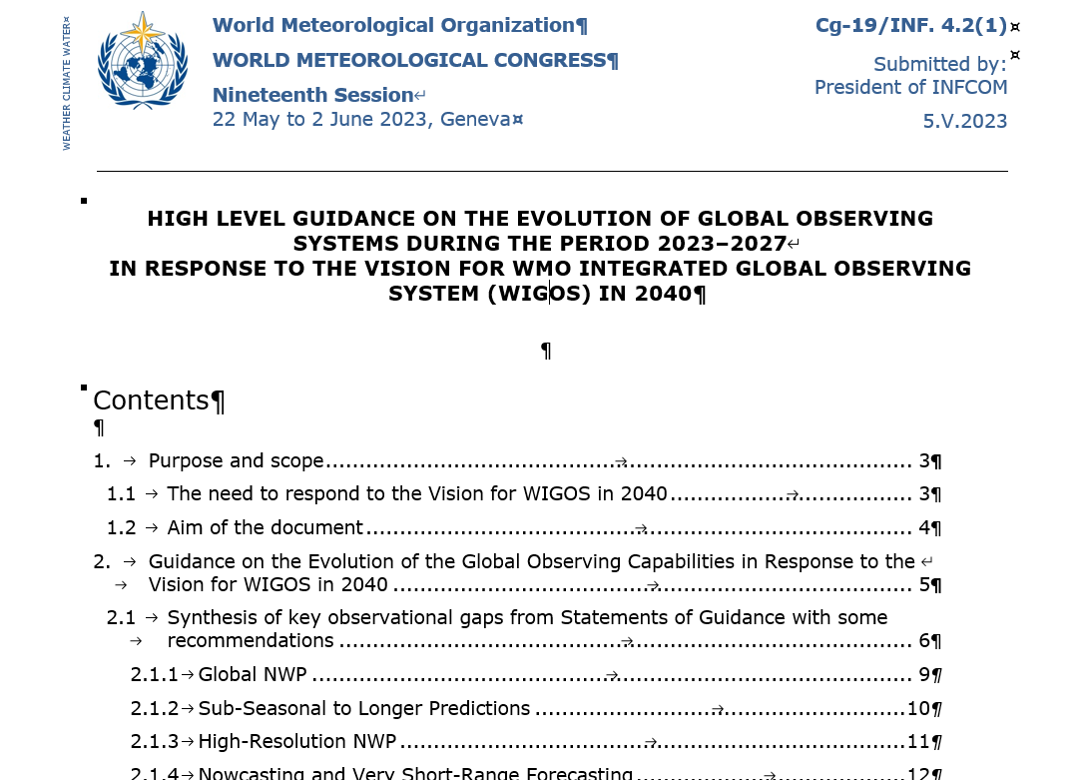
Deliverables
“High Level Guidance on the evolution of global observing systems during the period 2023-2027 in response to the Vision for WIGOS in 2040”
The High-Level Guidance document itself
Five Chapters (~60 pages), six Annexes (~60 pages)
Reviewed by JET-EOSDE, SC-ESMP, SC-ON, SERCOM, Research Board, co-sponsors, INFCOM management group, INFCOM-2
Executive Summary (5 pages)
Reviewed by SC-ON, INFCOM management group, INFCOM-2
 | 4

Slide 5
High Level Guide – priority actions to Members 2023-2027
10 General recommendations
e.g. on GBON, data policy, tiered networks
10 recommendations on the evolution of observing systems
e.g. exchange data having impact on NWP, remote and radar sensing data
5 specific recommendations on sensor technology
e.g. GNSS, Doppler wind profilers, new lidar systems
4 specific recommendations on Integrated Urban Services for Members
e.g. metadata on urban observations, IUS reference stations, GHG monitoring in cities
12 specific recommendations on Space Systems
e.g. GHG monitoring from space, new generation of GEO satellites, RO constellation, space-based lidar for 3D winds
 | 5

Slide 6
The High Level Guide - innovations
The Earth System approach provides opportunities for cooperation across the different domains weather, climate, hydrology, atmospheric composition, oceans, cryosphere, and space weather.
The guidance document presents results from NWP and other WMO application areas with respect to observations in all domains.
Monitoring allows the implementation actions to be adjusted according to evolving requirements, technology, and opportunities.
Reflects WMO current priorities and focus areas
Links with GBON, RBON and the unified data policy.
 | 6

Slide 7
Next steps
Congress invited to adopt Draft Resolution
Communication and outreach
Make document available in all WMO languages
PPT file, presenting the HLG-doc, enabling direct access for non-sequential reading of it (being developed)
PPT file, presenting the HLG content in summary to different audiences (to be developed)
Ways to be used :
In relation to the Unified Data Policy
For the expansion of GBON and the design of RBON by the regions
To promote further update of Technical Regulations
 | 7

Slide 8
High Level Guidance in response to WIGOS Vision 2040
Doc 4.2(1) – High Level Guidance (HLG) on the Evolution of Global Observing Systems during the period 2023 to 2027 in Response to WIGOS Vison 2040
Draft Resolution 4.2(1)/1 (Cg-19)
Executive Summary of HLG document in annex to draft Resolution
Complete document provided in INF 4.2(1)
 | 8

Slide 9
Thank you
^{wmo.int}

